Slide 1

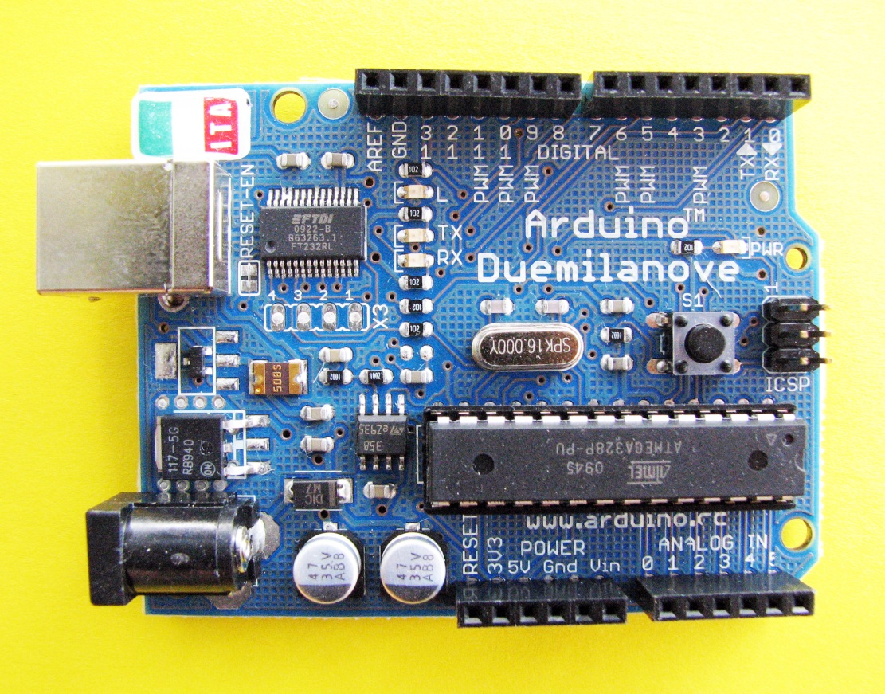
Analog and Digital Measurements
Instrumentation
14 digital input / output pins
6 analog input pins

Slide 2
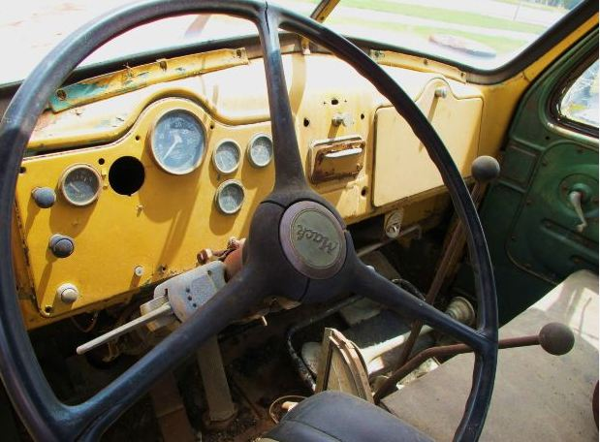
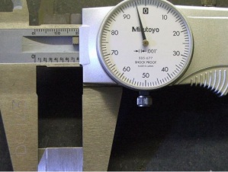
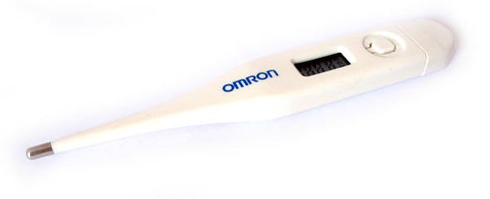
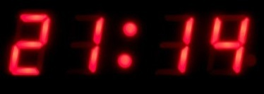

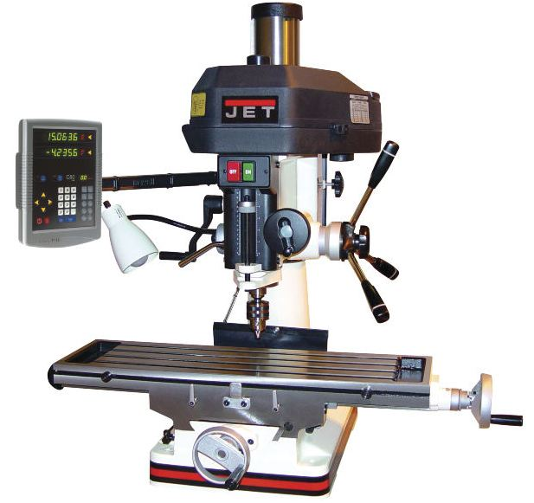
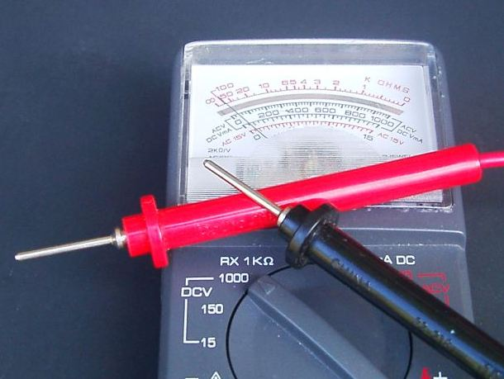
Instrumentation
A digital system is a data technology that uses discrete (discontinuous) values. By contrast, analog (non-digital) systems use a continuous range of values to represent information. Although digital representations are discrete, they can be used to carry either discrete information, such as numbers, letters or other individual symbols, or approximations of continuous information, such as sounds, images, and other measurements of continuous systems.

Slide 3
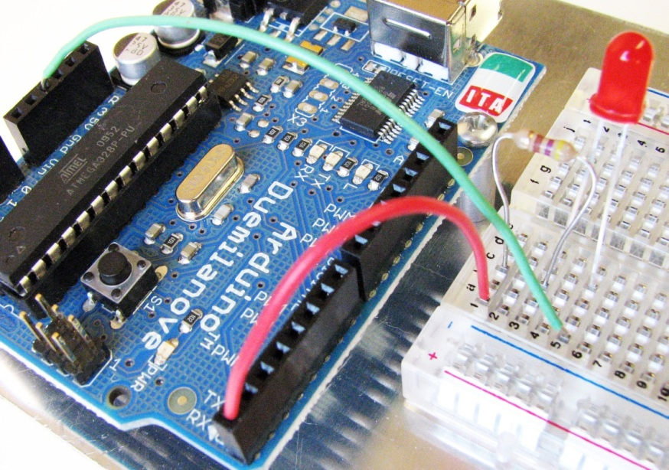
Instrumentation
Inputs and Outputs
An input “receives” information or senses a voltage in the external world.
An output “delivers” information or makes something happen in the external world.
Below is an example from an earlier class where we made an LED flash on and off.
Are we using digital pin 0 as an input or an output?
digital output
void setup() {
pinMode(0, OUTPUT);
}
void loop() {
digitalWrite(0, HIGH);
delay(1000);
digitalWrite(0, LOW);
delay(500);
}

Slide 4
Instrumentation
Receiving Input from an Arduino
digital input
analog input
int val;
val = digitalRead(7);
int val;
val = analogRead(5);
val is either 0 or 1
0 = voltage sensed at digital pin 7 is LOW (0V)
1 = voltage senses at digital pin 7 is HIGH (5V)
val is an integer between 0 and 1023
0 = voltage sensed at analog pin 5 is zero volts
1024 would correspond to five volts at pin 5 (can only go to 1023 though, so a little top end range is lost)
Guess what val would be if the voltage sensed at analog pin 5 was 2.5V?
512

Slide 5
Instrumentation
Digital Inputs
The Arduino reference indicates that digitalRead() will return . . .
a value of HIGH if the voltage at the digital input pin is greater than 3 volts
a value of LOW if the voltage at the digital input pin is less than 2 volts.
5
4
3
2
1
0
high
digitalRead()returns HIGH or 1
voltage (V)
ambiguous
digitalRead()may return a value of HIGH or LOW
low
digitalRead()returns LOW or 0
0 1 2 3 4 5 6 7 8 9
time (milliseconds)
LOW or HIGH???

Slide 6
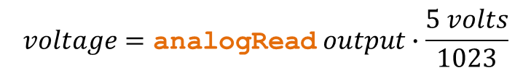

Instrumentation
Analog Inputs
The analog input pins on your Arduino have 10-bit resolution and consequently measure in (2)¹⁰ or 1024 increments.
$${\left(2\right)}^{10}=1024$$
The analogRead() functions returns a value between 0 and 1023, where 0 is zero volts and 1024 would be 5 volts.
$$voltage=\text{analogRe}\text{ad} output∙\frac{5 volts}{1023}$$
smallest increment of voltage that can be read = 0.00489 volts

Slide 7



Instrumentation
Examples
point 1
point 2
point 3
5
4
3
2
1
0
digitalRead()returns HIGH or 1
voltage (V)
digitalRead()may return a value of HIGH or LOW
digitalRead()returns LOW or 0
0 1 2 3 4 5 6 7 8 9
time (milliseconds)
data point from plot above | If a digital pin is used to sample voltage | if an analog pin is used to sample voltage
 | output of digitalRead() | hypothetical analogRead() output | voltage computed from analogRead() output
1
0
217
$$217∙\frac{5V}{1023}=1.061V$$
2
ambiguous
526
$$526∙\frac{5V}{1023}=2.571V$$
3
1
964
$$964∙\frac{5V}{1023}=4.711V$$

Slide 8
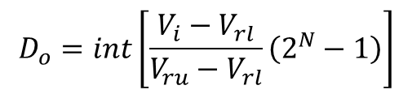
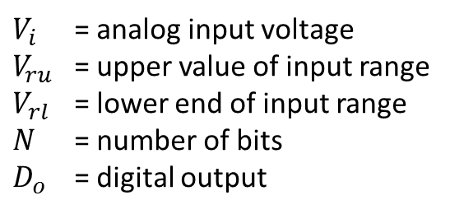
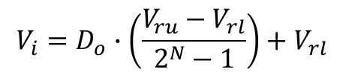
Instrumentation
generalizing A/D conversion
For a simple binary converter, the digital output of an A/D converter is . . .
$$D_{o}=int\left[\frac{V_{i}−V_{rl}}{V_{ru}−V_{rl}}\left(2^{N}−1\right)\right]$$
and the corresponding voltage for a given digital output is . . .
$$V_{i}=D_{o}∙\left(\frac{V_{ru}−V_{rl}}{2^{N}−1}\right)+V_{rl}$$
where
$V_{i}$ = analog input voltage $V_{ru}$ = upper value of input range $V_{rl}$ = lower end of input range
$N$ = number of bits
$D_{o}$ = digital output

Slide 9

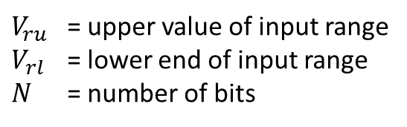
Instrumentation
quantizing error
An error exists because the A/D inversion process return an integer.
input resolution error$=±0.5∙ \frac{V_{ru}−V_{rl}}{2^{N}−1}$volts
where
$V_{ru}$ = upper value of input range $V_{rl}$ = lower end of input range
$N$ = number of bits
Example Problem A 12-bit A/D converter has an input range of -10 to +10 V. Find the resolution error of the converter for the analog input.
input resolution error = $±0.5∙\frac{10V−\left(−10V\right)}{2^{12}−1}=±0.00244V$
The resolution uncertainty of $±0.00244V$ is the best that can be achieved.

Slide 10
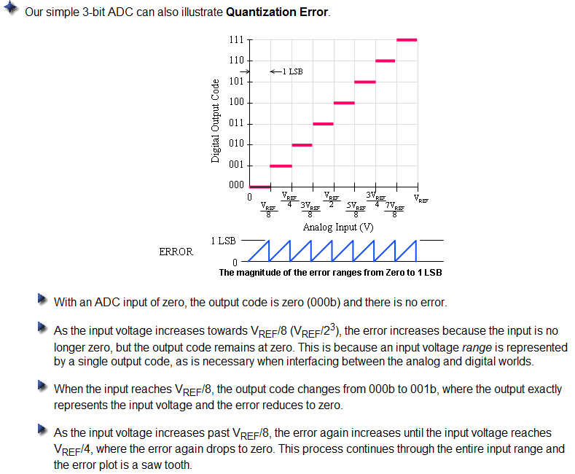
Instrumentation
http://www.national.com/AU/design/courses/259/
quantizing error

Slide 11
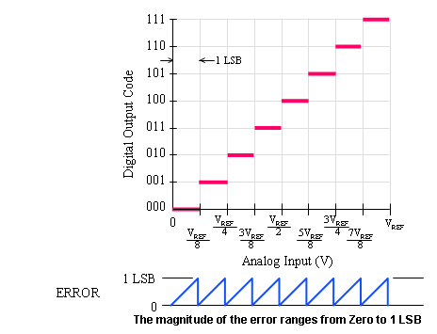
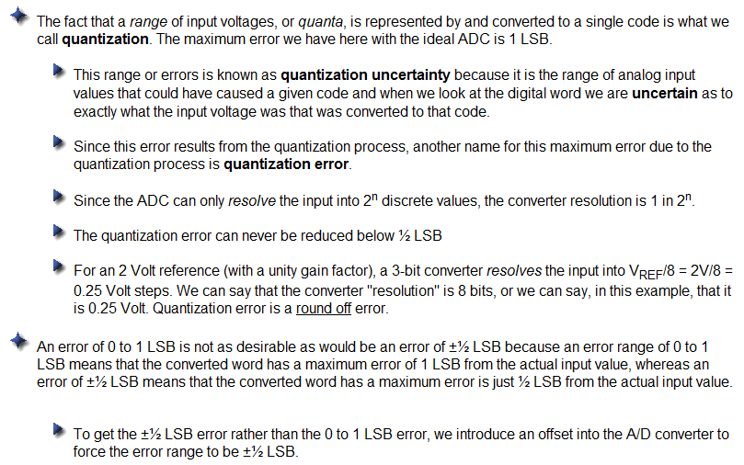
Instrumentation
http://www.national.com/AU/design/courses/259/
quantizing error

Slide 12
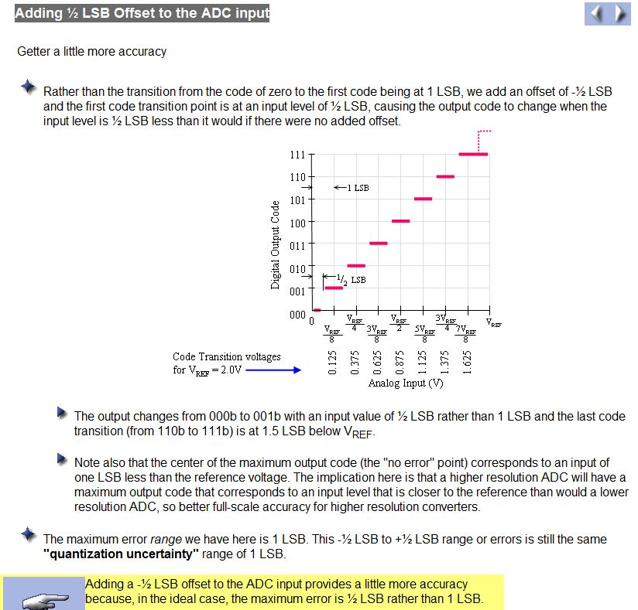

Instrumentation
http://www.national.com/AU/design/courses/259/
offset makes error $±$ 1 LSB

Slide 13
Instrumentation
other errors
ADCs are also subject to the following errors:
linearity
zero
gain
thermal stability
sampling rate
ADCs only work within their intended range.

